Slide 1
A Smart Healthcare system for monitoring and predicting infection probability for COVID patients

Slide 2
Idea of the Project:
An Approach to a cost effective Solution for Health Monitoring system at a safe distance from patient and oxygen cylinder level monitoring using Internet Of Things and to develop a Machine Learning model that predicts the percentage of Covid-19 based on patient’s body vitals. The Android mobile application is responsible for providing notifications and alerts for the potentially infected patient family respondents. The integrated system has mobile application synchronized for predicting and alarming the situation. The design serves as an essential platform that defines the measured readings of COVID-19 symptoms for monitoring, management, and analysis.
Innovative method:
A new approach is to build a ML model by transferring patient’s raw data, which is monitored and it gives high prediction accuracy. This is a cost effective way for taking care of covid patients even after their post covid observation at home.
22 January 2022
2

Slide 3
Problem Statement
During peak periods of COVID the availability of beds for the COVID patient in hospitals became rare, so there occurs a situation where the affected person should be taken care at home from a safer distance and their guardian or doctor are in need to monitor the patient’s body vitals and oxygen level in the oxygen cylinder. This situation becomes more crucial when there is sudden increase in the patients body vitals. During this situation the person who is taking care of the patient may get affected, so they are in need to monitor the patient from a safer distance. This is the main problem we are attempting to solve so that the single person medical assistance could be effective.
22 January 2022
3

Slide 4
Concept of Solution
The main objective of the proposed idea is to monitor the body vitals of covid patients ,by using sensors like Pulse Oximeter(MAX30102),Temperature probe(DS18B20),ECG sensor(AD8232).Also MEMS pressure sensor is used to monitor the oxygen cylinder level.
We use ESP-32 module for interfacing the sensors. Using Internet Of Things(IOT) the body condition of the patient regularly updated in the health monitoring portal. This will also create alert notification during unstable condition. This portal can also be accessed through mobile application.
We use a Machine learning technique that predicts the probability of infection rate of the patient. The algorithm used is Logistic regression. The result of this prediction will be updated in the web portal.
The complete set-up of health monitoring system makes sure that the patient is in normal condition. The system alerts the care taker in case of emergency.
The whole idea mainly ensures that ,there is no contact between patient and others, this will be a effective solution for home quarantine of covid patients. Most of existing systems are used in hospital by the professional doctors, This system can be used by normal person for taking care of covid patients at home.
22 January 2022
4

Slide 5
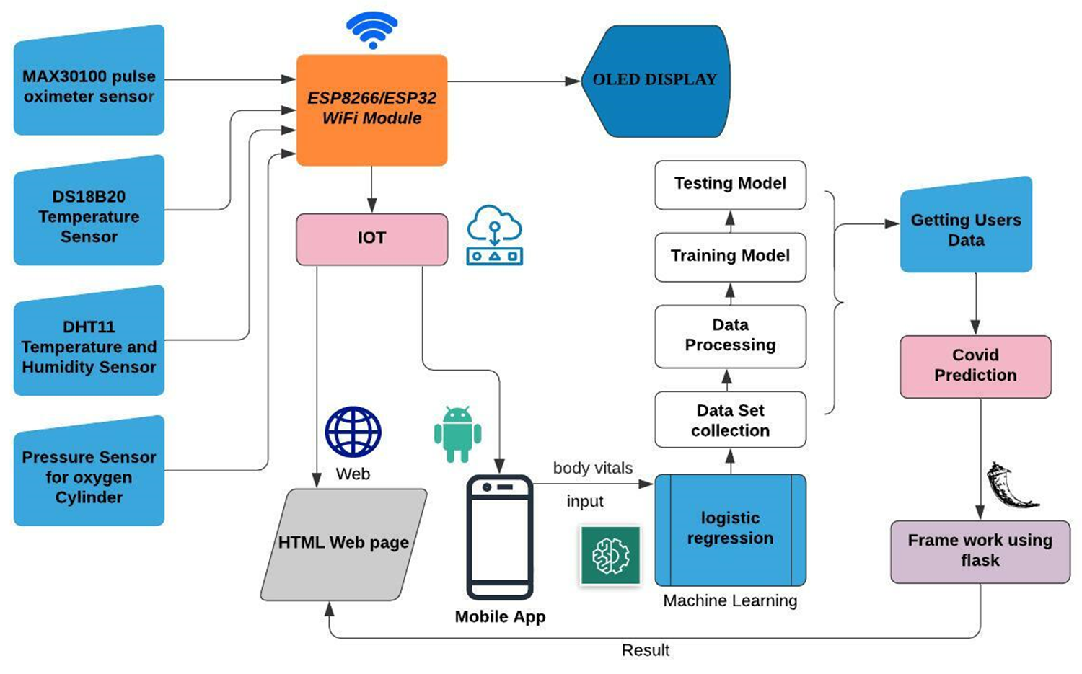
Concept Block diagram
22 January 2022
22 January 2022
5

